Slide 1

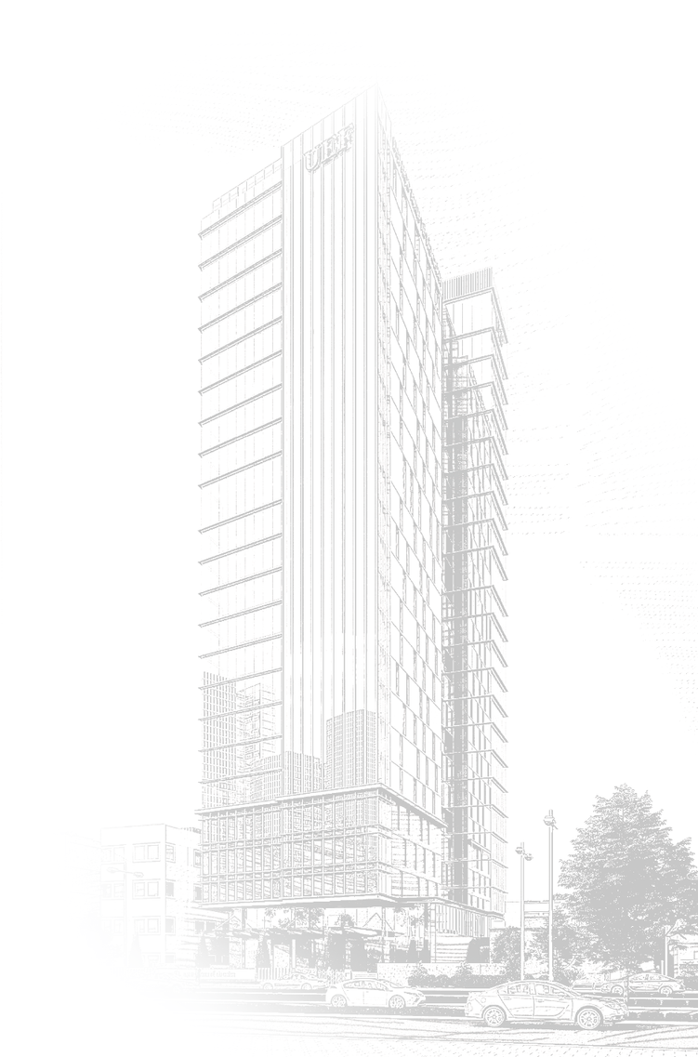
MINISTRY OF EDUCATION AND TRAINING
UNIVERSITY OF ECONOMICS - FINANCE
HO CHI MINH CITY
Project Management
Subject: Mobile Device Programming
Final Report
Instructor guides: Lê Viết Linh
Team 2:
Trương Hùng Dũng
Nguyễn Hòa Hồng Đức
Nguyễn Văn Mạnh
UNIVERSITY OF ECONOMICS - FINANCE HO CHI MINH CITY www.uef.edu.vn
HO CHI MINH CITY

Slide 2
Content
Project Management
1. Database
2. Layout - Logic
3. Demo
UNIVERSITY OF ECONOMICS - FINANCE HO CHI MINH CITY www.uef.edu.vn

Slide 3
Database
UNIVERSITY OF ECONOMICS - FINANCE HO CHI MINH CITY www.uef.edu.vn

Slide 4
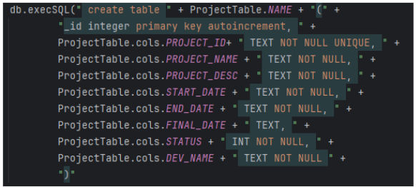
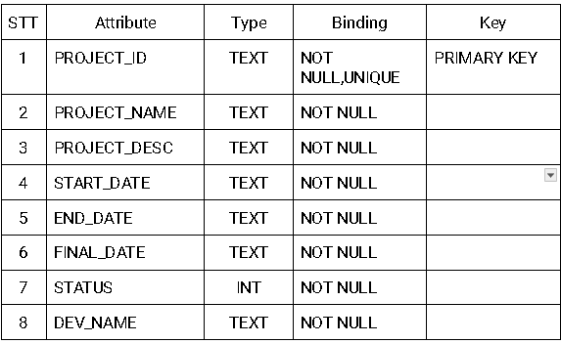
Database
Project Table
Our code of Project Table in Project Management
UNIVERSITY OF ECONOMICS - FINANCE HO CHI MINH CITY www.uef.edu.vn

Slide 5
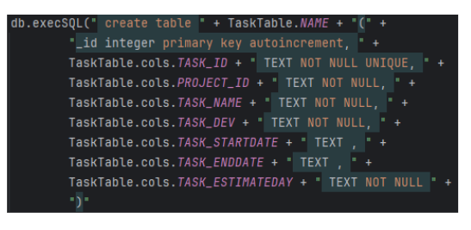
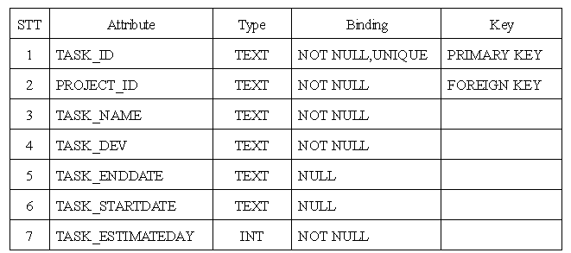
Database
Task Table
Our code of Task Table in Project Management
UNIVERSITY OF ECONOMICS - FINANCE HO CHI MINH CITY www.uef.edu.vn

Slide 6
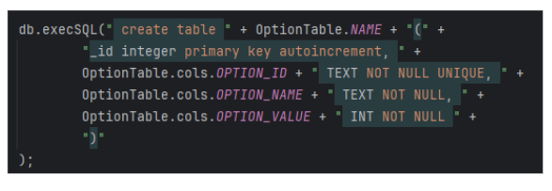
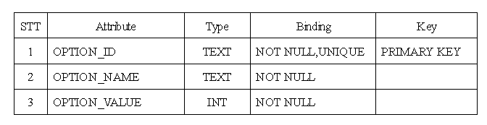
Database
Option Table
Our code of Option Table in Project Management
UNIVERSITY OF ECONOMICS - FINANCE HO CHI MINH CITY www.uef.edu.vn

Slide 7
Layout - Logic
UNIVERSITY OF ECONOMICS - FINANCE HO CHI MINH CITY www.uef.edu.vn

Slide 8
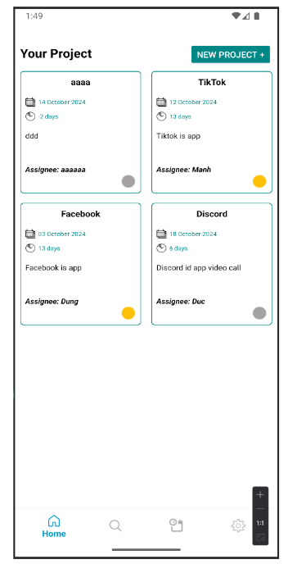
Home Fragment Layout
Layouts that show all the projects that the user has created.
Use Recyclerview to render items (using a layout named item_project.xml). Then shoot the data from the DB into the Recyclerview Adapter to display it to the user.
You can Mutiple Select these items and delete them and delete the Tasks in those projects (which will be reviewed in the Testing section).
Clicking on any item will show a Model bottom sheet for users to edit or view project details (will be reviewed in the Testing section).
UNIVERSITY OF ECONOMICS - FINANCE HO CHI MINH CITY www.uef.edu.vn

Slide 9
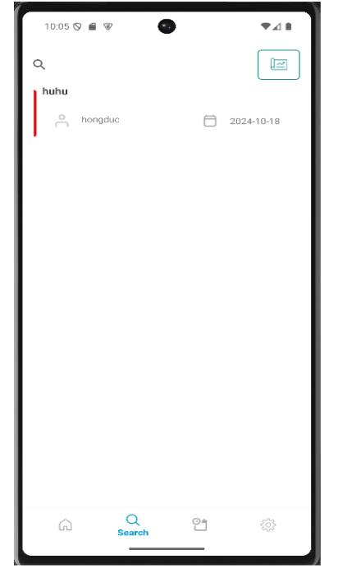
Search Fragment Layout
-> Is the Project list display screen based on search.
-> Use Recyclerview to display items (using layout named item_searcch.xml) based on edittext user entered to display item.
-> User can search project name or person name by clicking the button next to Edittext.
UNIVERSITY OF ECONOMICS - FINANCE HO CHI MINH CITY www.uef.edu.vn

Slide 10
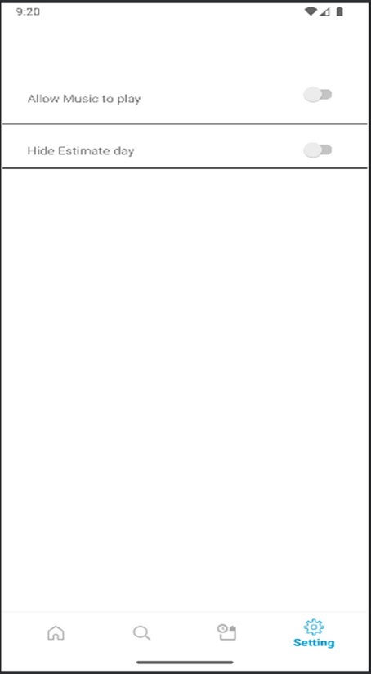
Setting Fragment Layout
It is a setting screen that allows the user to hide or display the Estimate day and turn on or turn off the music .
After the user clicks on the switch to turn on music, it will allow a service that is PlayMusicSevice, to launch and when turned off, it will disable the PlayMusicService.
The user after clicking on the hidden estimatedate will update the hidden status of the estimatedate in the project detail by save it in the database and editing the SetVisibility. (Gone) of the TextView.
UNIVERSITY OF ECONOMICS - FINANCE HO CHI MINH CITY www.uef.edu.vn

Slide 11
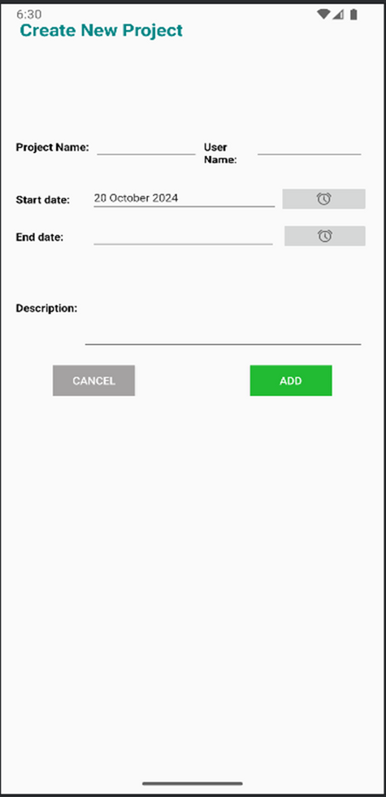
Create new project
This is a screen that allows users to create a new project and save it in the database.
Users will enter the project name and Dev name using the phone's keyboard.
Enter the startdate and enddate by clicking the button with the clock icon to open the DatePicker Model and select the date.
If the user does not enter anything or is missing a field, the application will fire a message informing the user that they need to fill in all.
After entering all the information and clicking the "Save" button, it will proceed to save it in the database.
UNIVERSITY OF ECONOMICS - FINANCE HO CHI MINH CITY www.uef.edu.vn

Slide 12
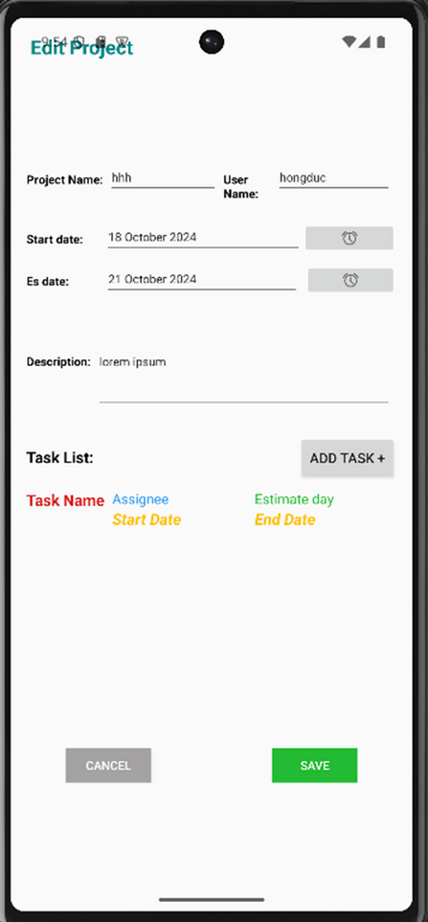
Edit project
This is a screen where users can edit the project's information and update the project's data in the database.
The user enters the information of the project to be edited in the Edittext and selects the start and end dates of the project by clicking on the clock icon to open a DatePicker Model and select the date.
Users can add tasks to the project. A project will be able to have one or more tasks, but this is not required.
Users can write a description for the project by typing characters from the keyboard into EditText .
Users will be able to update the project by clicking the "Save" button to save the information to the database.
If you press "Cancel", you will cancel the update progress and return to the previous activity.
UNIVERSITY OF ECONOMICS - FINANCE HO CHI MINH CITY www.uef.edu.vn

Slide 13
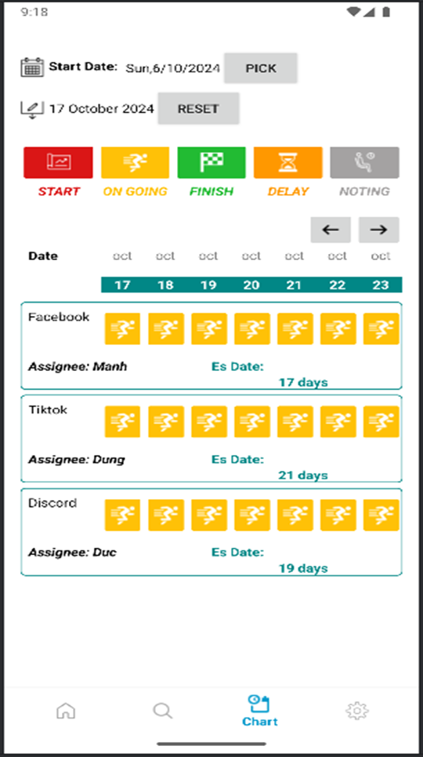
Chart
As a roadmap display for each project
Users can pick a date to check which projects are in the process of running for the next 7 days
If you don't pick the date, the app will take the current date to the next 7 days and show up the projects that are in those 7 days
In the 7 days that are displayed in the user layout, it is possible to view the details of each day in these 7 days, by clicking on the date the user wants to view and a BottomSheet Model Date Details will appear (which will be reviewed in the Testing section).
BottomSheet Modal Date Details in this screen:
is the modal containing the project information and the date selected by the user
The date gap in this Modal will be calculated from the project's Enddate - the date the user wants to view
Adjust project status to delay or Resume
Adjust the project status to Completed
UNIVERSITY OF ECONOMICS - FINANCE HO CHI MINH CITY www.uef.edu.vn

Slide 14
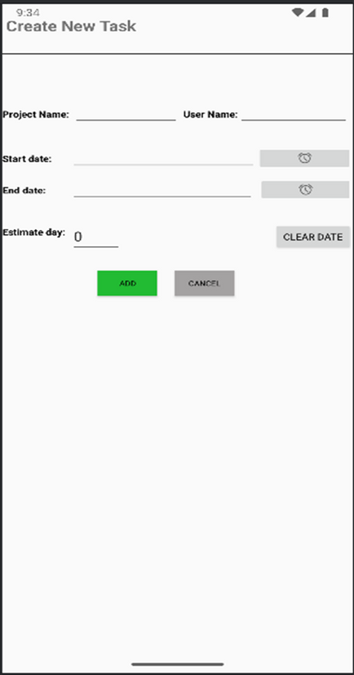
Create new task
This is the Add Task screen in a previously selected project from "Edit Project Activity".
The users will enter the Task name and Dev name using the phone's keyboard.
Enter the startdate and enddate by clicking the button with the clock icon to open the DatePicker Model and select the date.
In the Estimate day field, users have 2 options:
If the user selects the Start Date and End Date fields, the Estimate day field will automatically calculate the Date Range and will not be entered by the user.
If the user does not select the Start Date and End Date, the application will force the user to enter the Task name, Dev name, and Estimate day.
UNIVERSITY OF ECONOMICS - FINANCE HO CHI MINH CITY www.uef.edu.vn

Slide 15
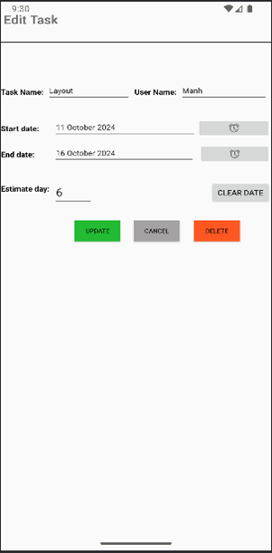
Edit task
This is a screen where users can edit the information of the task and update that information to the database.
The user enters the information of the task to be edited into the Edittext and selects the start and end dates of the task.
Users can reset the startdate, enddate, and estimate date by clicking the "CLEAR DATE" button.
Users will be able to update the task by clicking the "Update" button to save the information to the database.
If you press "Cancel", you will cancel the update progress and return to the previous Activity.
UNIVERSITY OF ECONOMICS - FINANCE HO CHI MINH CITY www.uef.edu.vn

Slide 16
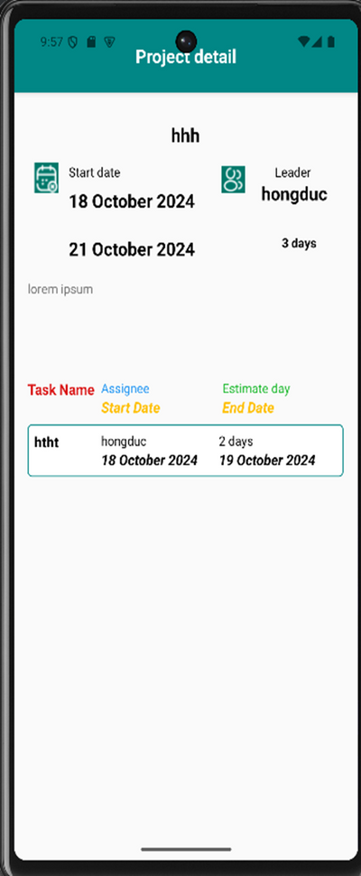
Project detail
This is the screen that displays the information of the project including: Project name, dev name, startdate, enddate, estimeday.
In addition, display the information of the task including: Task name, dev name, startdate, enddate, estimeday.
This screen only retrieves information from the database and displays on the edittext and has no additional functions. (just to see).
UNIVERSITY OF ECONOMICS - FINANCE HO CHI MINH CITY www.uef.edu.vn

Slide 17
Demo
UNIVERSITY OF ECONOMICS - FINANCE HO CHI MINH CITY www.uef.edu.vn

Slide 18

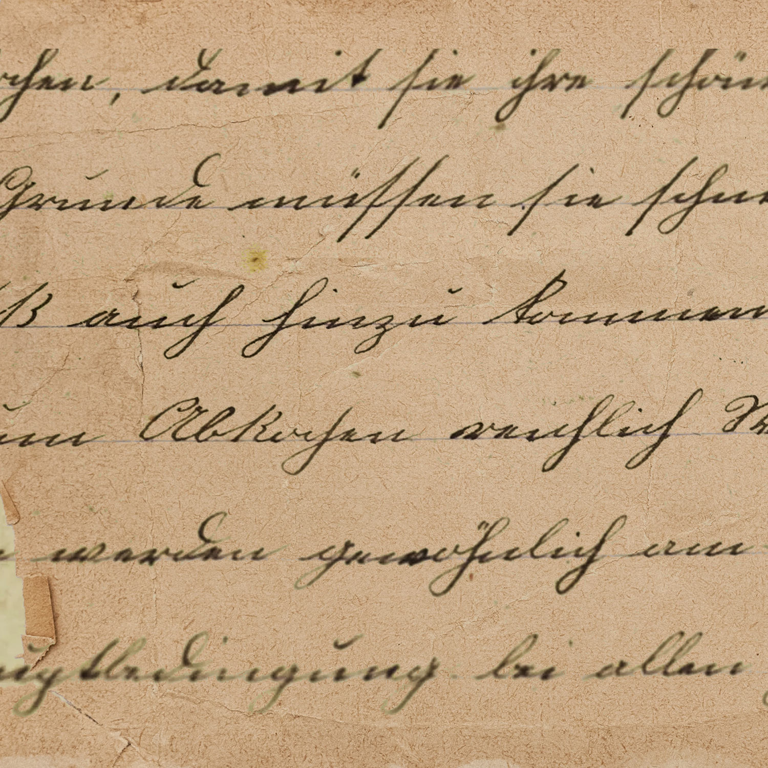





www.reallygreatsite.com
Thank
you

